Slide 1
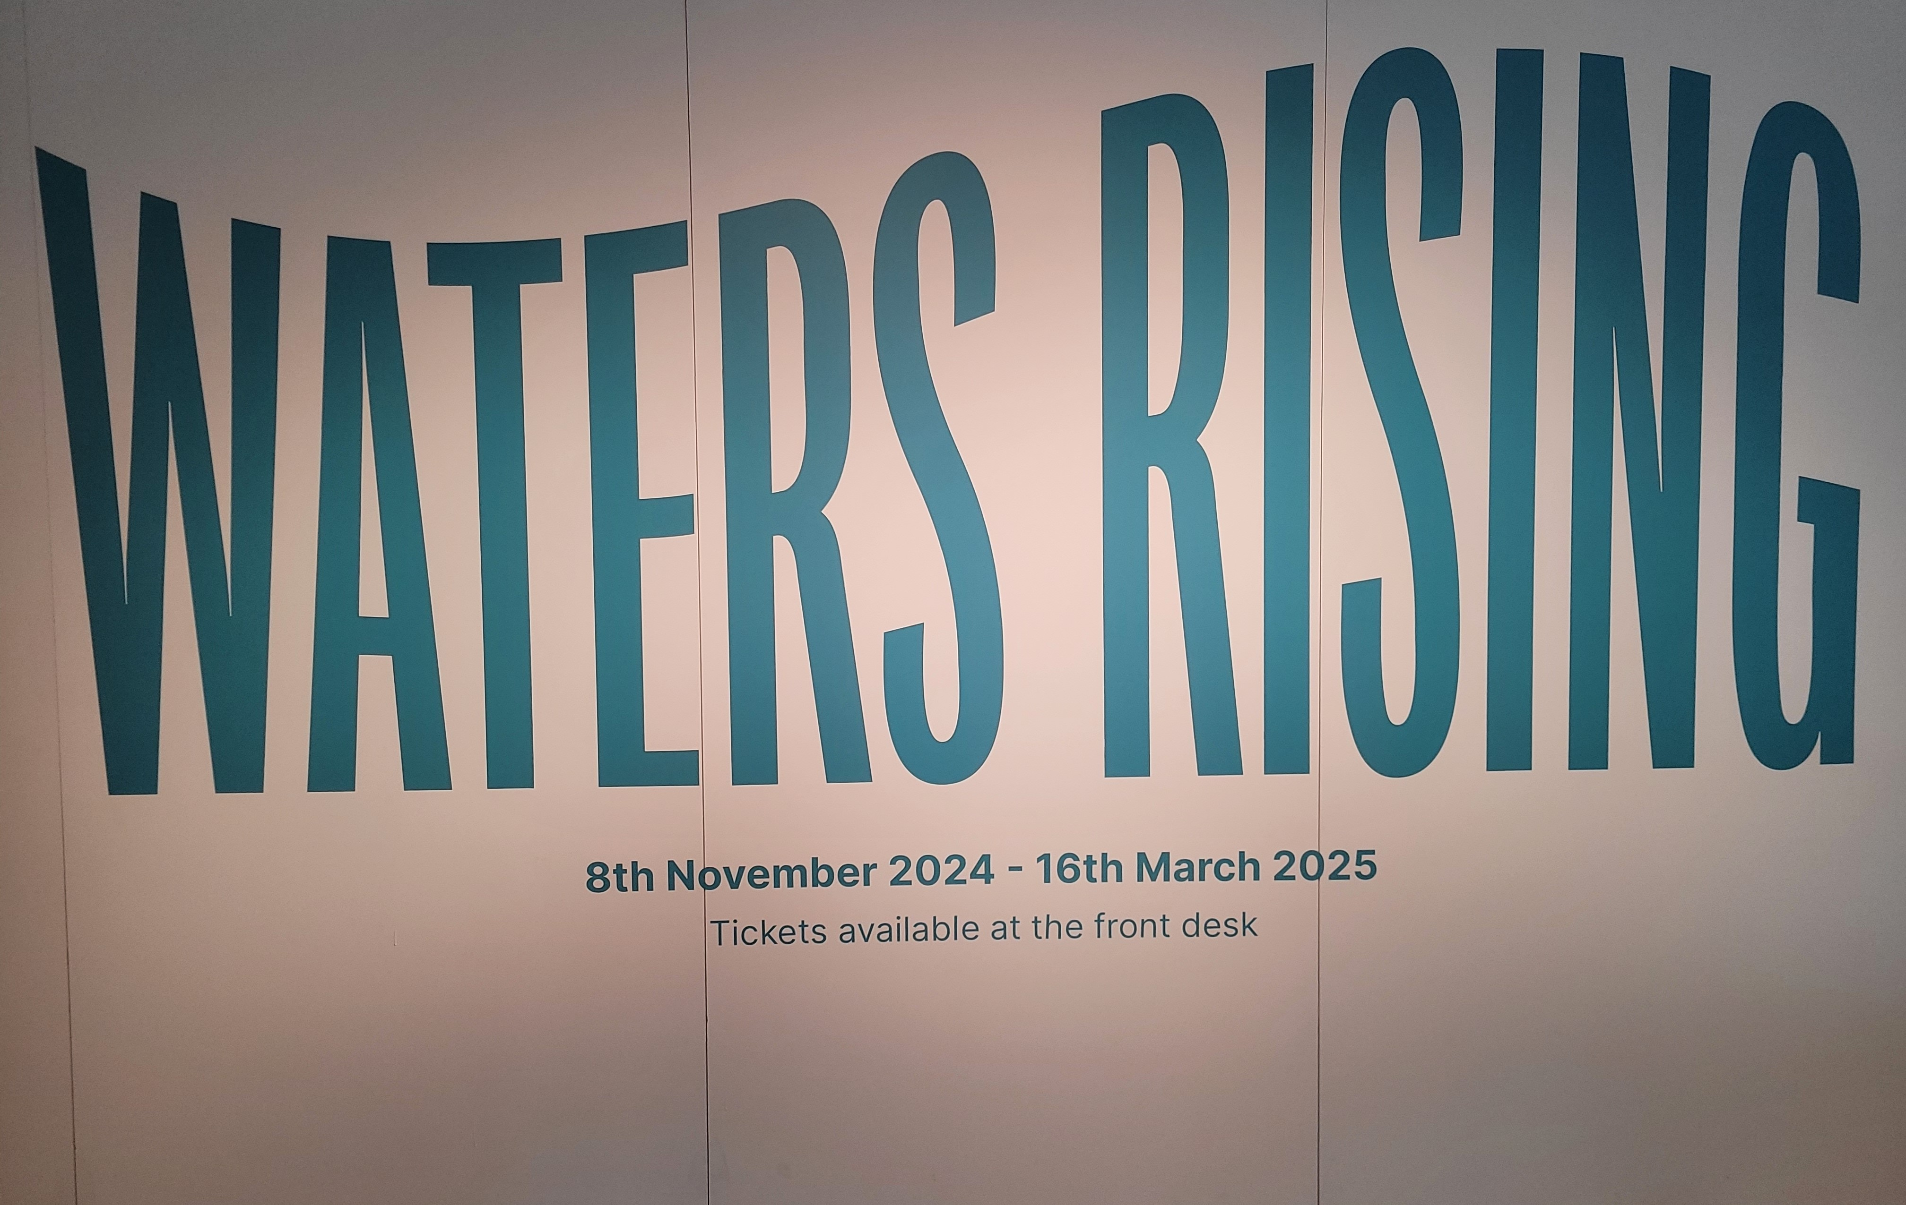

Notes:
“Waters Rising” at Perth Museum ran from November 2024- March 2025
Waters Rising traces stories and objects connected to flooding from Scotland and abroad, from biblical accounts to Ancient Egypt to North America, and more recent events closer to home. Exploring the growing threat of the global climate emergency whilst examining the impact of flooding and extreme weather events on communities, businesses, and infrastructure in Perth and Kinross, the exhibition also includes photos, memories, and stories from local people.
You can complement your visit by looking at our Natural History, and Prehistory galleries to inspire conversation about how the waterways have been used in Ancient Perth, and the animals throughout history which have been impacted by climate change, and flooding.
http://perthmuseum.co.uk/learn

Slide 2
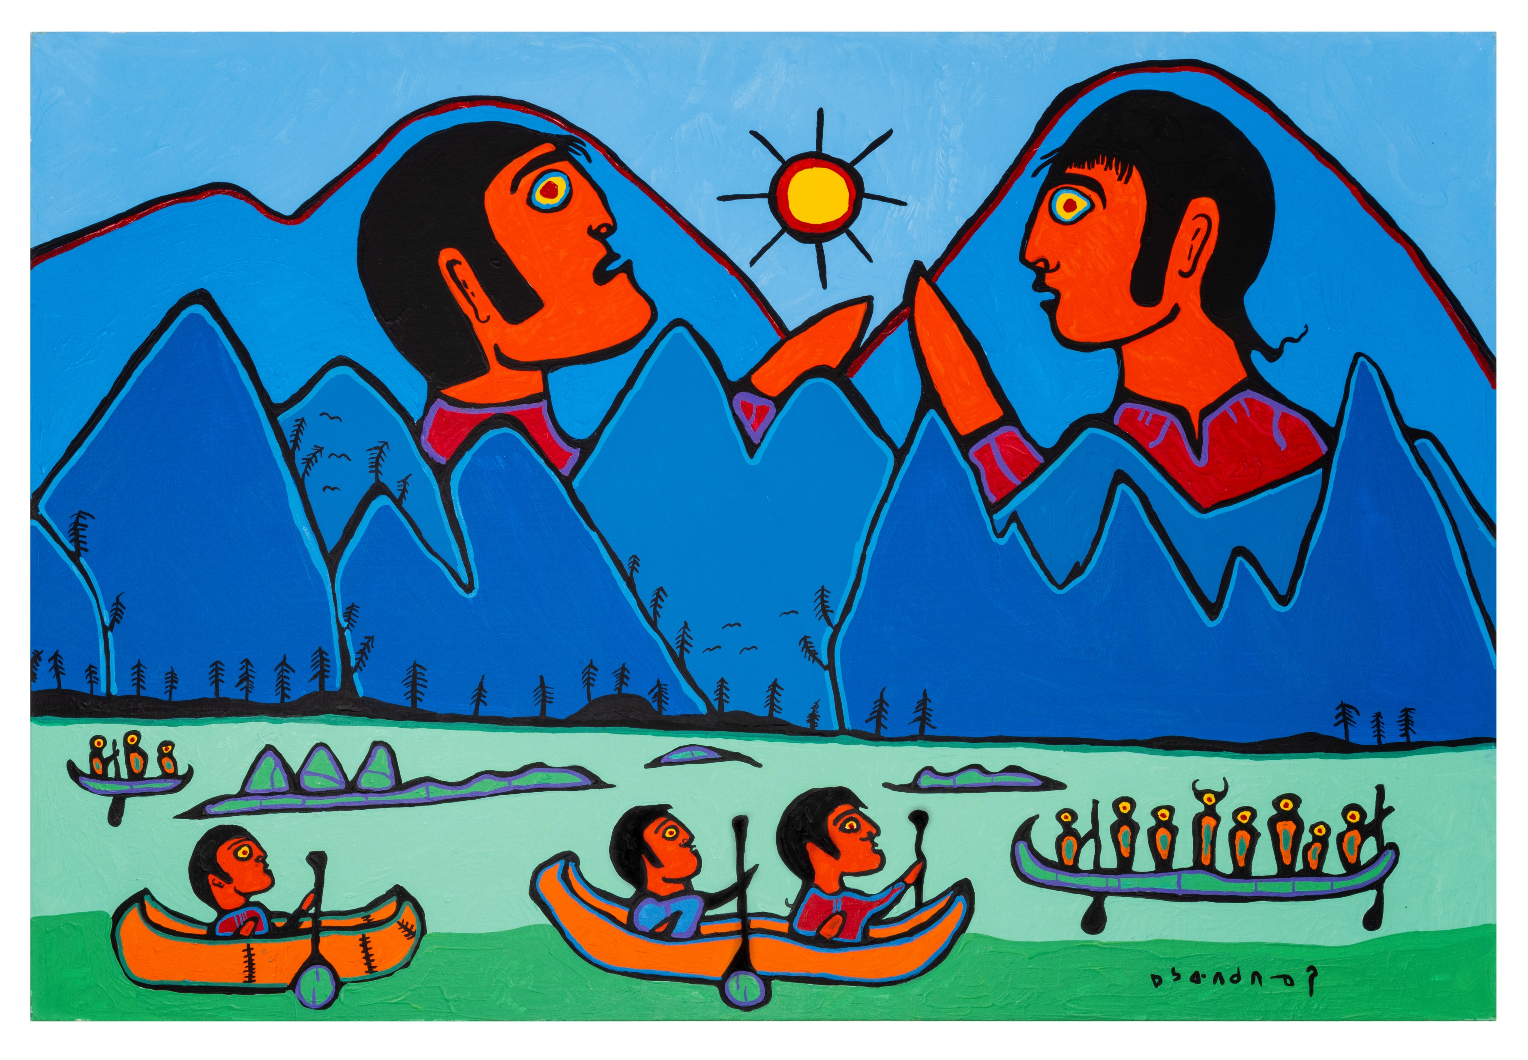
Notes:
Image :Painting by Norval Morrisseau
Information:
This is a vibrant and striking artwork that incorporates Indigenous art styles by a Canadian Artist Norval Morrisseau.
Morrisseau’s works often reflect a deep connection between humans, nature, and the spiritual world.
The piece features bold colours, simplified shapes, and symbolic imagery. Prominent figures are depicted as part of the natural landscape, suggesting a connection between people and their environment. The composition includes canoes with paddlers in the foreground, mountains in the background, and two large human faces integrated into the mountain forms. The sun is also a central, symbolic element.
Question:
If you could step into this painting, would you prefer to be on a boat or on dry land? Can you make up a story about what is unfolding around you?

Slide 3
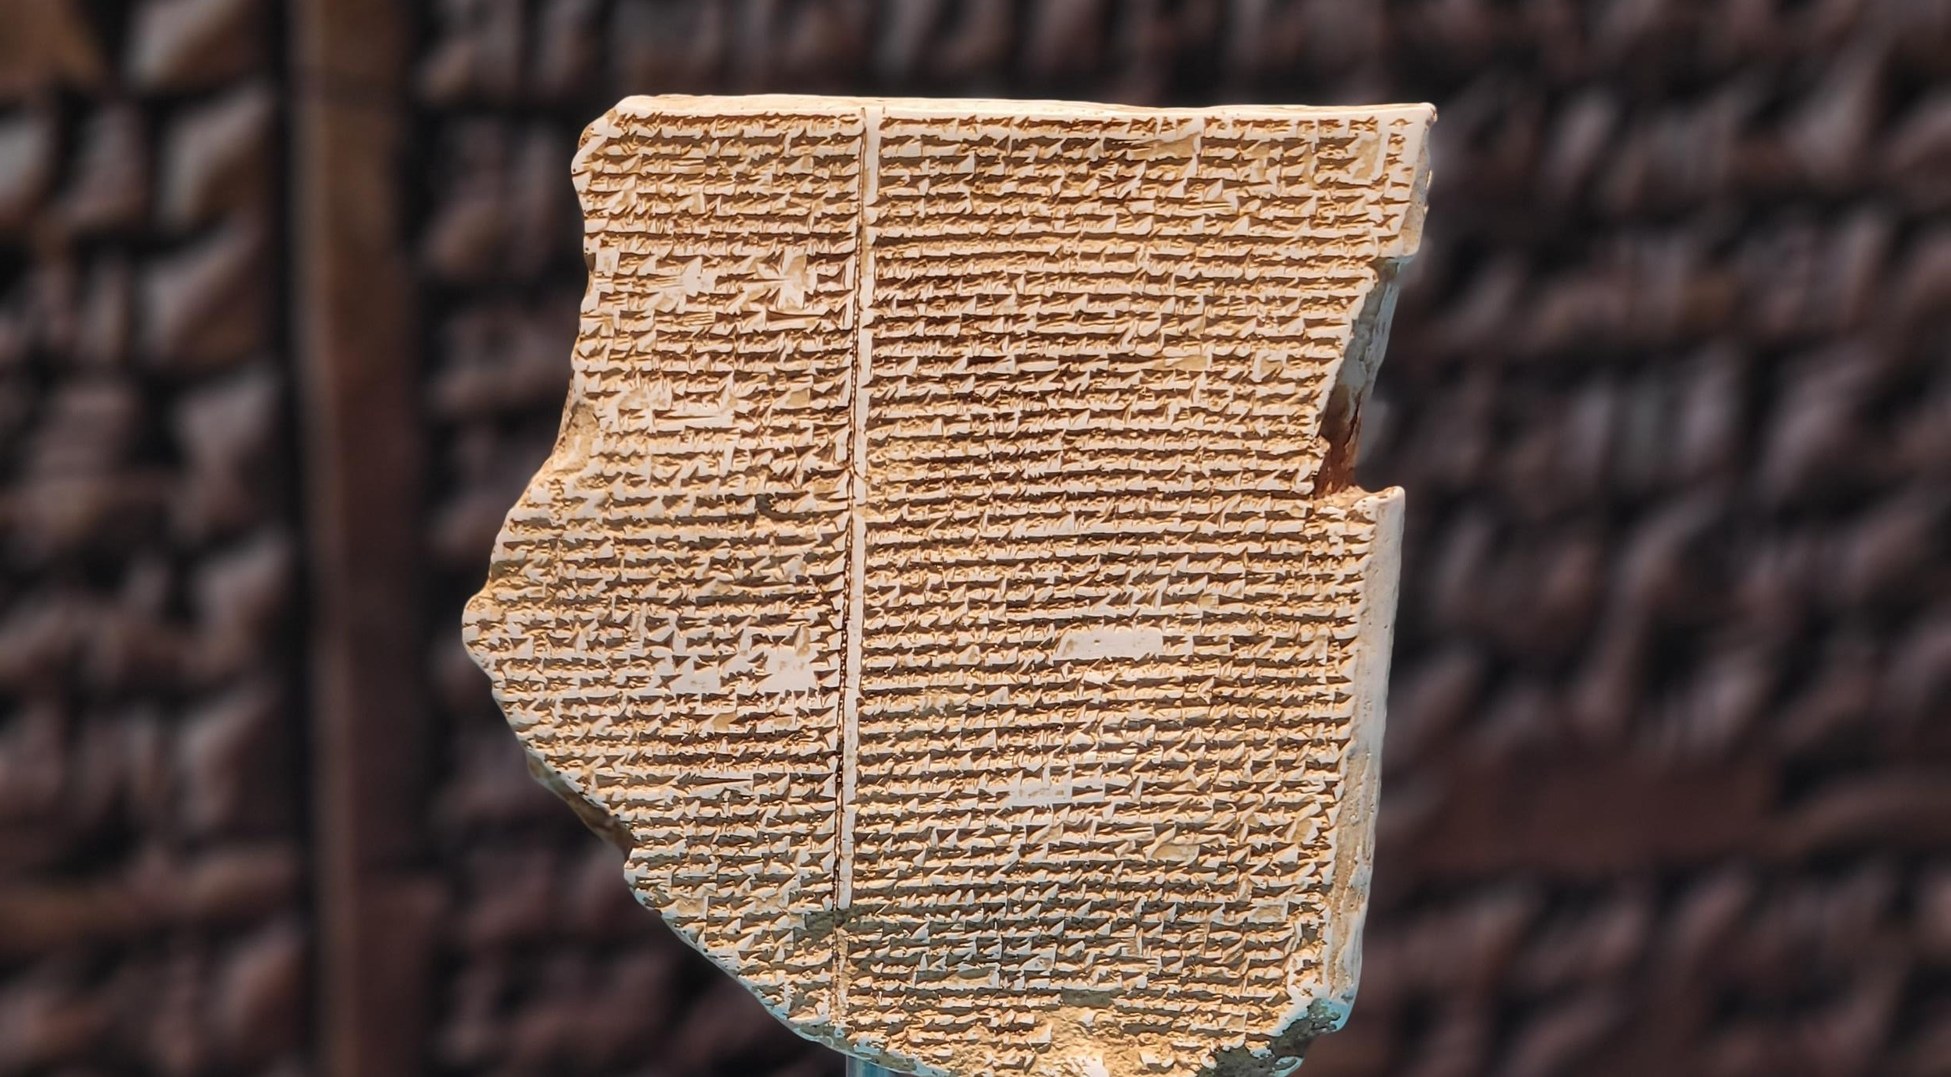
Notes:
Image : Clay tablet with the writings of “ Epic of Gilgamesh”.
Information:
This is a replica fragment of a clay tablet with cuneiform writing, one of the oldest writing systems, used in ancient Mesopotamia. Tablets like this recorded laws, stories, and myths.
This particular tablet contains part of the Epic of Gilgamesh, one of the earliest works of literature, written around 2100 BCE. It tells the story of Gilgamesh, the semi-divine king of Uruk, and his search for meaning, immortality, and companionship. Key moments include his friendship with Enkidu, their battles with creatures like Humbaba and the Bull of Heaven, Enkidu’s death, and Gilgamesh’s quest to find Utnapishtim, who was granted immortality after surviving a great flood.
Question:
If you were to leave a message for future generations, what message would you leave and why?

Slide 4
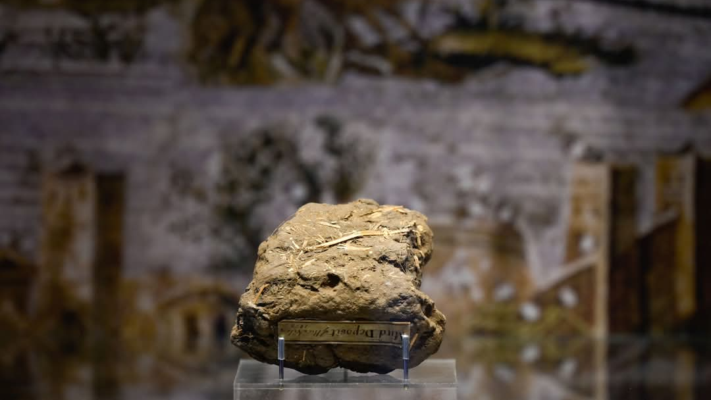
Notes:
Image : A mud deposit from the River Nile.
Information:
The Nile flooding refers to the annual inundation of the Nile River, primarily in Egypt and Sudan, which historically occurred between June and September. This natural phenomenon was a result of seasonal rains in the Ethiopian highlands, where the Blue Nile originates. The flooding brought nutrient-rich silt that fertilized the surrounding land, making it ideal for agriculture, particularly for growing crops like wheat and barley.
The ancient Egyptians relied heavily on the annual floods for their agricultural activities and societal sustenance. They developed a calendar based on this cyclical event, allowing them to plan planting and harvesting. The flooding was a crucial factor in the civilization's success, stability, and growth.
Question:
Can you think of an example of communities that still depend on seasonal flooding?

Slide 5
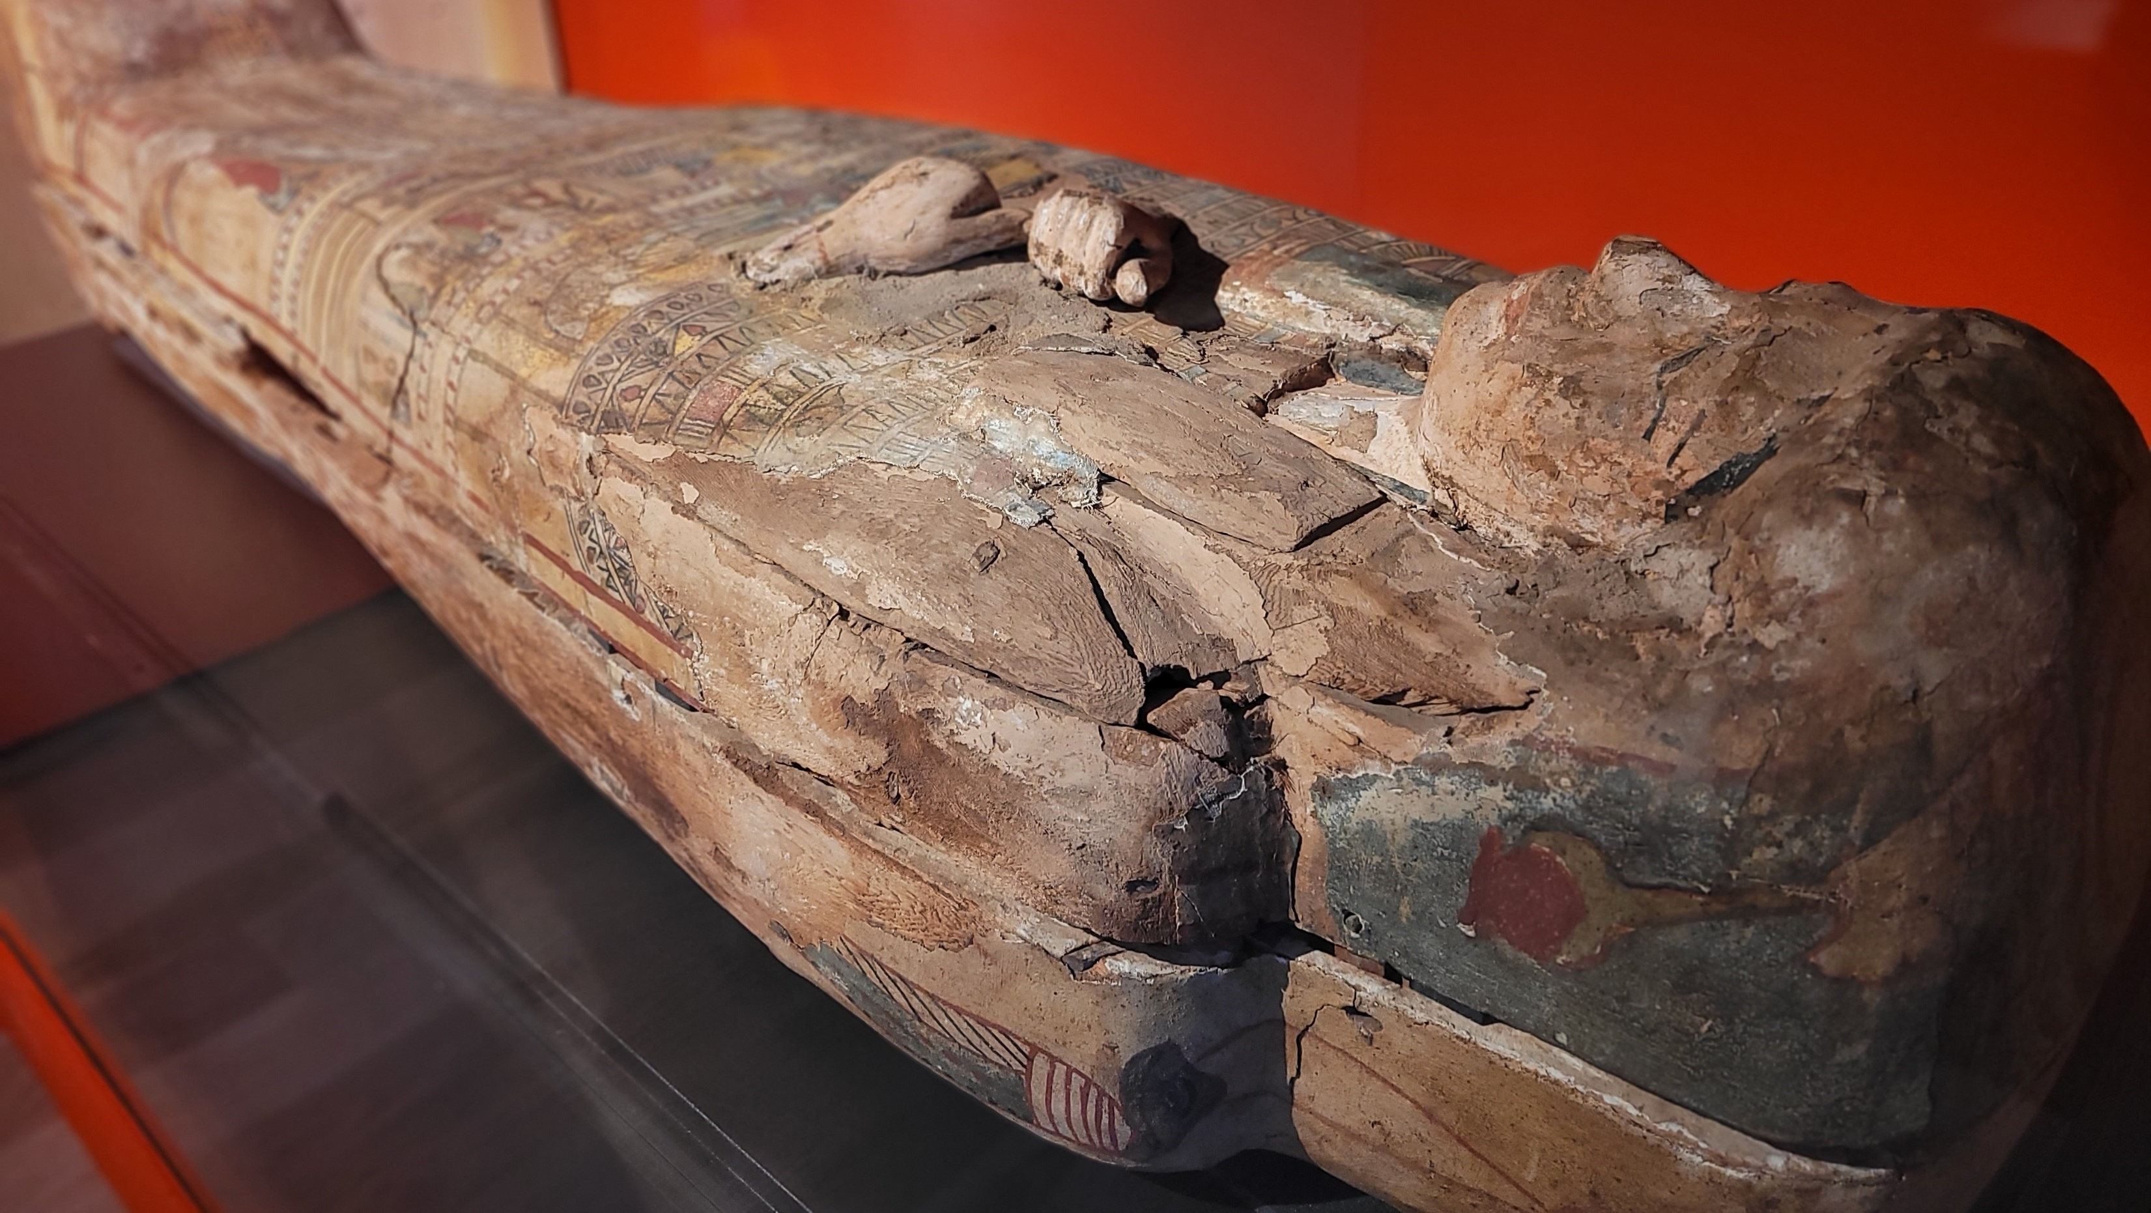
Notes:
Image: Sarcophagus on display at Perth Museum.
Information:
This is the sarcophagus of Ta-Kr-Hb, likely from Akhmim, Upper Egypt. The coffin experienced flooding (likely from the Nile) and grave-robbing in ancient times, so it’s uncertain if the body inside is truly Ta-Kr-Hb, as named on the coffin lid. In such cases, priests often rewrapped bodies and placed them in any available coffin to restore order.
In the 1890s, a Scottish businessman from Alloa acquired the coffin and remains in Cairo and donated them to his hometown. When the local museum closed in 1936, the sarcophagus and body were transferred to the former Perth Museum & Art Gallery. When you come to the exhibition you will view a facial reconstruction video of TaKrHb.
Question:
How do you feel about the idea of having your coffin or skeleton exhibited in a museum?

Slide 6
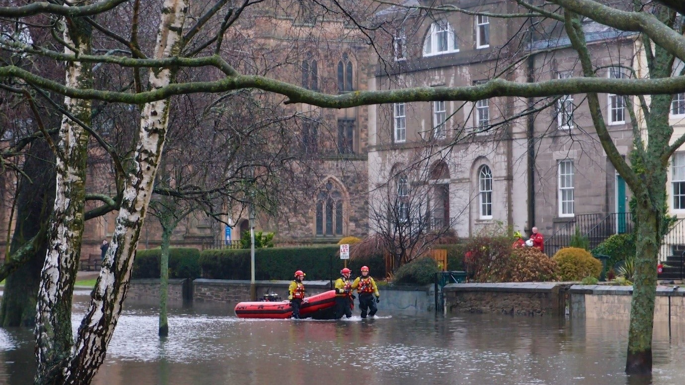
Notes:
Image : Marshall Place , Perth 1993.
Information:
During the 1993 floods in Perth, Scotland, emergency services played a crucial role in assisting residents affected by rising waters. Firefighters were deployed to conduct rescues, using boats to reach individuals stranded in their homes. Police helped with evacuation efforts, ensuring safety and directing traffic away from flooded areas. Local councils coordinated response efforts, providing shelters for displaced residents and managing relief services. Additionally, volunteers joined the effort, offering support and assistance to those in need. This collective response highlighted the community's resilience and the vital role of emergency services in times of crisis.
Question:
What are the most precious items in your home you would not want to be damaged by a flood and why? Do any of your family or friends remember witnessing a flood and what can they remember?

Slide 7
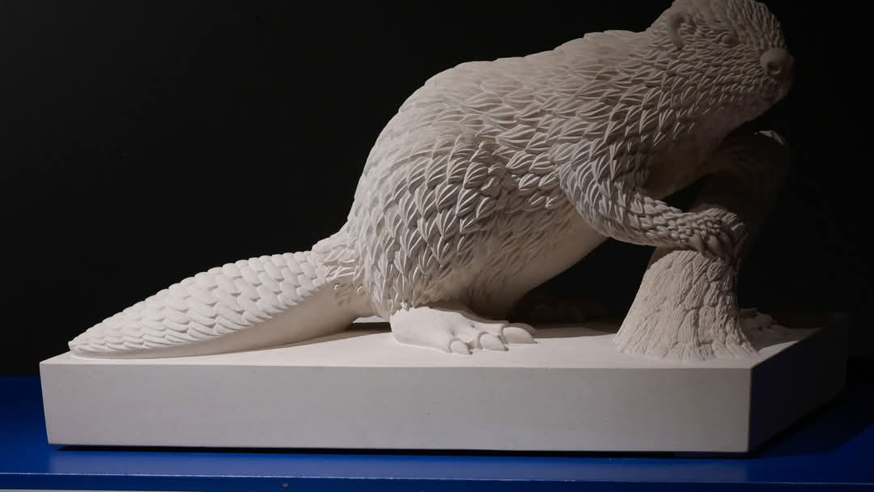
Notes:
Image : Michelle de Bruin 1967 ‘Beaver’ sculpted of Limestone.
Information:
Beavers have returned to Scotland after 400 years after nearly being hunted to extinction in the 1700’s for their fur, and since 2019 are a protected species. Beavers are semi-aquatic mammals known for their distinctive flat tails and webbed feet. They build dams primarily to create ponds, which provide them with a safe habitat from predators and a steady food supply. In rural areas like Perthshire, beavers play a crucial role in ecosystem management. Their dams help regulate water flow, improve water quality, and create wetlands that support biodiversity. These wetlands also help mitigate flood risks by absorbing excess water. Additionally, beaver activity can enhance the landscape by promoting growth of riparian vegetation, benefiting other wildlife and contributing to overall environmental health.
Question :
If the Beavers had a moto for their dam building efforts during the flood season, what do you think it would be and why?

Slide 8
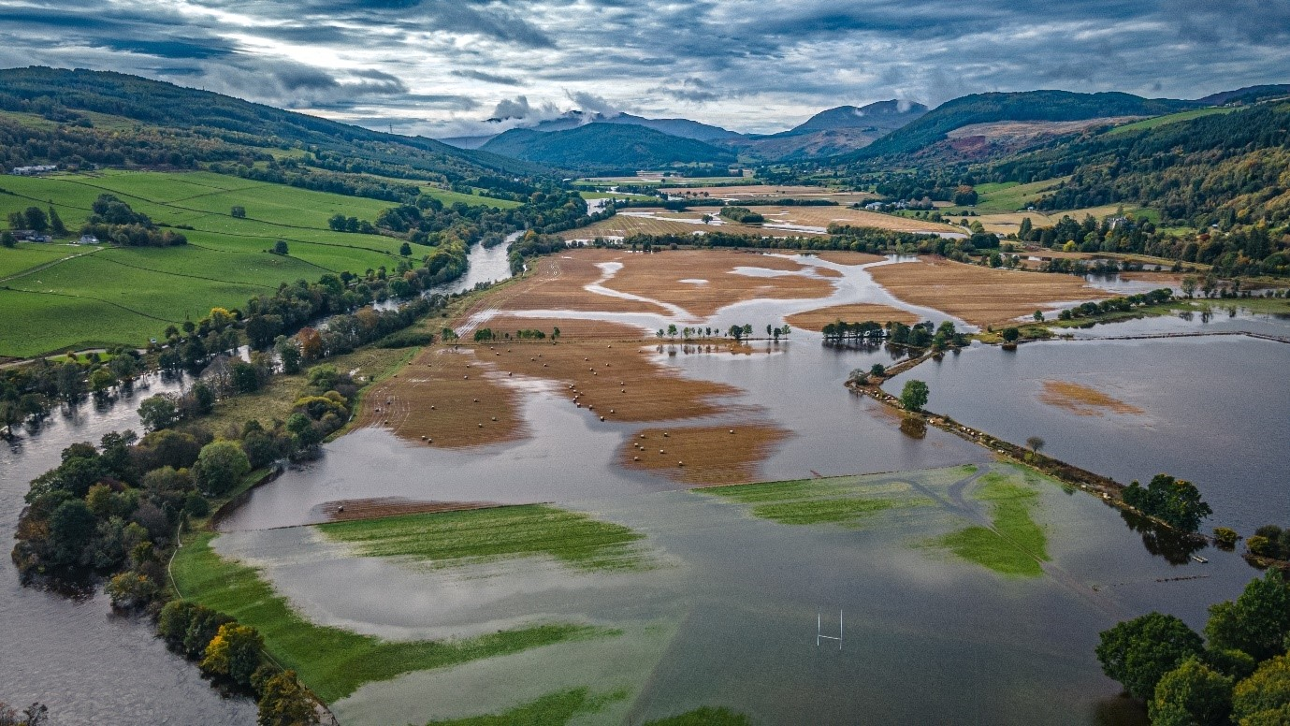
Notes:
Image : Sam Hayles – View of Aberfeldy 2023.
Information:
The flooding in rural Perthshire in 2023 brought several disadvantages, including damage to homes and infrastructure, which displaced residents and disrupted local services. Agriculture was notably affected, with fields inundated, leading to lost crops and financial strain on farmers. Additionally, the flooding posed risks to livestock, resulting in animal health issues and losses. The environment experienced erosion and habitat destruction, impacting local biodiversity.
Question:
When you look at this image, what does it make you think of, and feel?

Slide 9
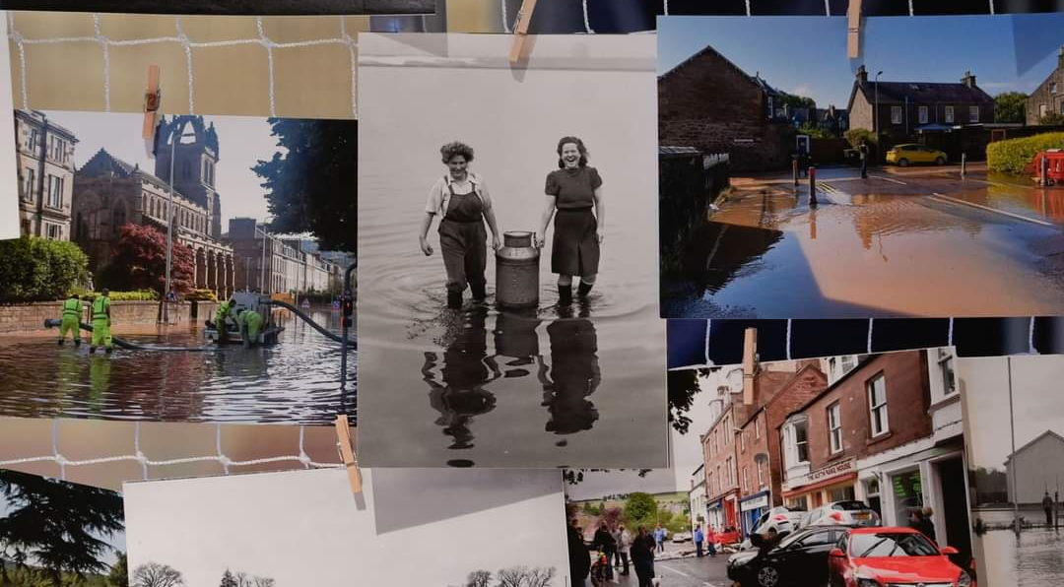
Notes:
Image : A variety of images from the collection at Perth Art Gallery.
Information:
Over the last hundred years, floods in Perthshire have significantly impacted local communities in various ways. Economically, recurrent flooding has led to damage to homes, businesses, and agricultural land, resulting in financial losses and decreased productivity.
Socially, communities have experienced disruptions, with some residents forced to relocate temporarily or permanently, leading to changes in local demographics and community ties. Infrastructure, including roads and bridges, has often been damaged, hindering transportation and access to services.
Environmentally, flooding has affected ecosystems, causing soil erosion and altering habitats. In response, local governments have increasingly invested in flood management systems and preventive measures, reflecting an ongoing adaptation to the challenges posed by flooding events. Overall, these floods have shaped the resilience and preparedness of communities in Perthshire over the century. Additionally, increased mental health issues may arise from the trauma and stress of flooding events.
Question:
During crisis, communities do their very best to support one another. Have a think how you would use your own skills to help people who have had to leave their home after it has been flooded. Would you cook meals for others, donate clothing and toys, help look after people's pets, organise activities to build moral?

Slide 10
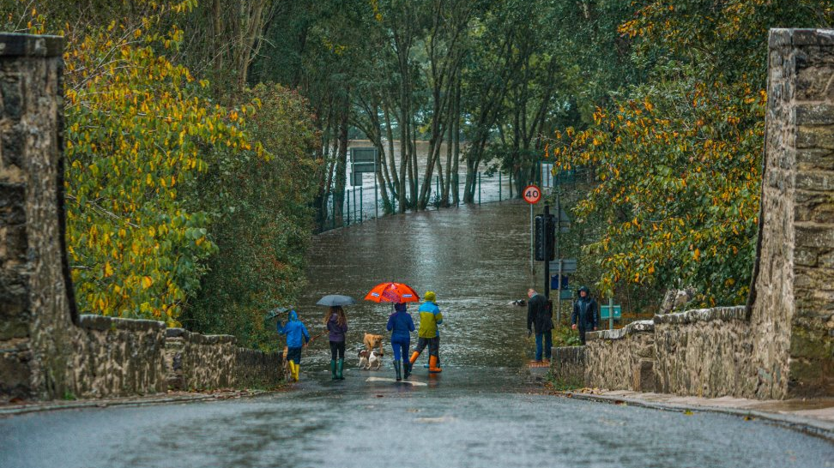

Thanks to the Gannochy Trust for funding the design of this PowerPoint
Notes:
Image : Sam Hayles – Wades bridge, Aberfeldy 2023 on display at Perth Museum ‘Waters Rising’ exhibition.
Information:
During the floods in Perthshire in 2023 , rural villages , towns and cities were severely affected by flooding. This is the view of local families attempting to walk out of Aberfeldy on Wades bridge to Weem, but the road is fully flooded.

